Slide 1

Exam SC-200: Microsoft Security Operations Analyst Crash Course
Tim Warner

Slide 2
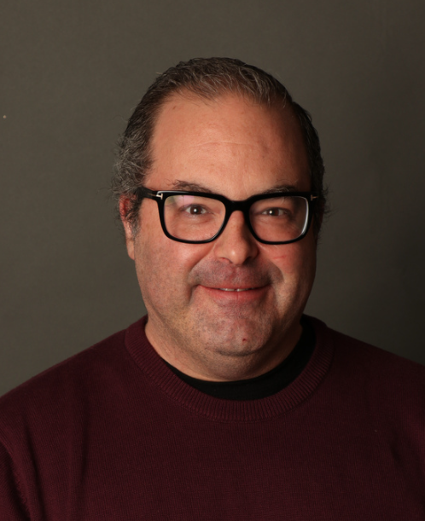
Tim Warner
Based in Nashville, TN, US
Central time zone
Senior Content Developer, Microsoft
MCT, former MVP
Twitter: @TechTrainerTim

Slide 3
Day 1 of 2 Agenda
Introduction
Design and implement data models (35–40%)
Design and implement data distribution (5–10%)

Slide 4
Day 2 of 2 Agenda
Content catch-up
Integrate an Azure Cosmos DB solution (5–10%)
Optimize an Azure Cosmos DB solution (15–20%)
Maintain an Azure Cosmos DB solution (25–30%)

Slide 5
Course Materials
timw.info/sc200

Slide 6
Course Expectations
Please review the recordings…several times!
10-minute break at midpoint
I’m here to answer your questions – take advantage of this
Use the Q&A panel

Slide 7
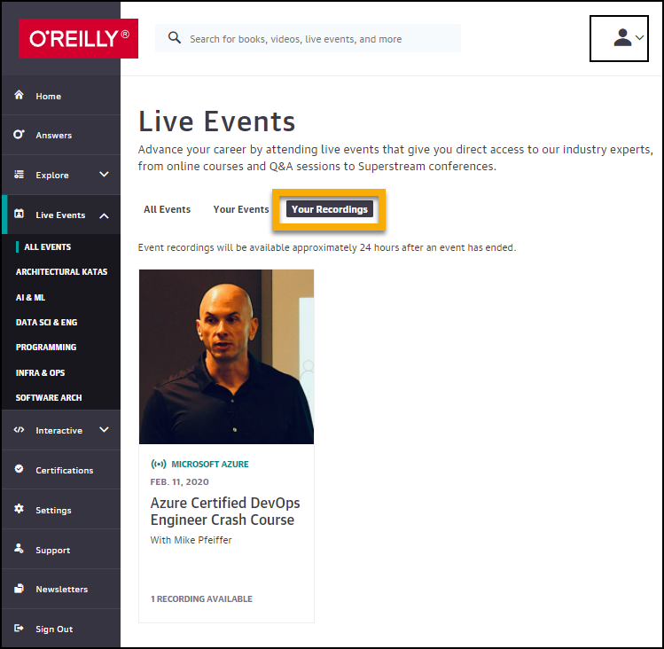
Session Recordings

Slide 8
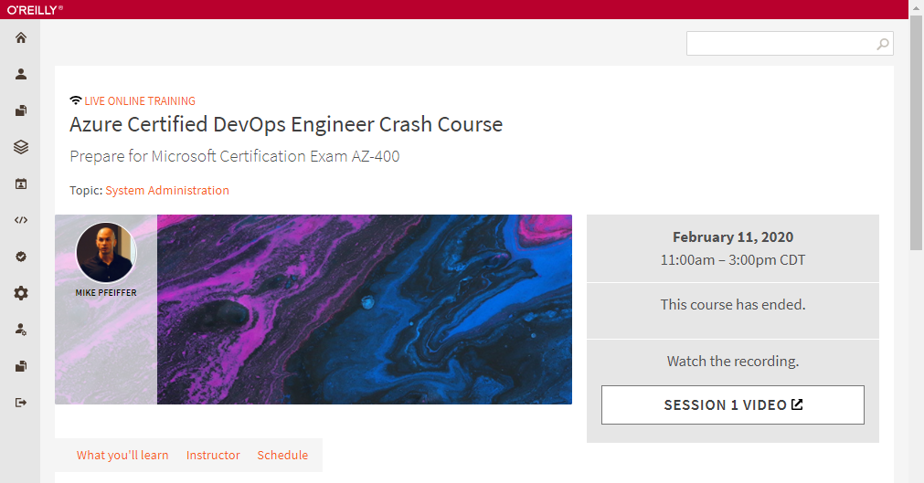
Session Recordings

Slide 9
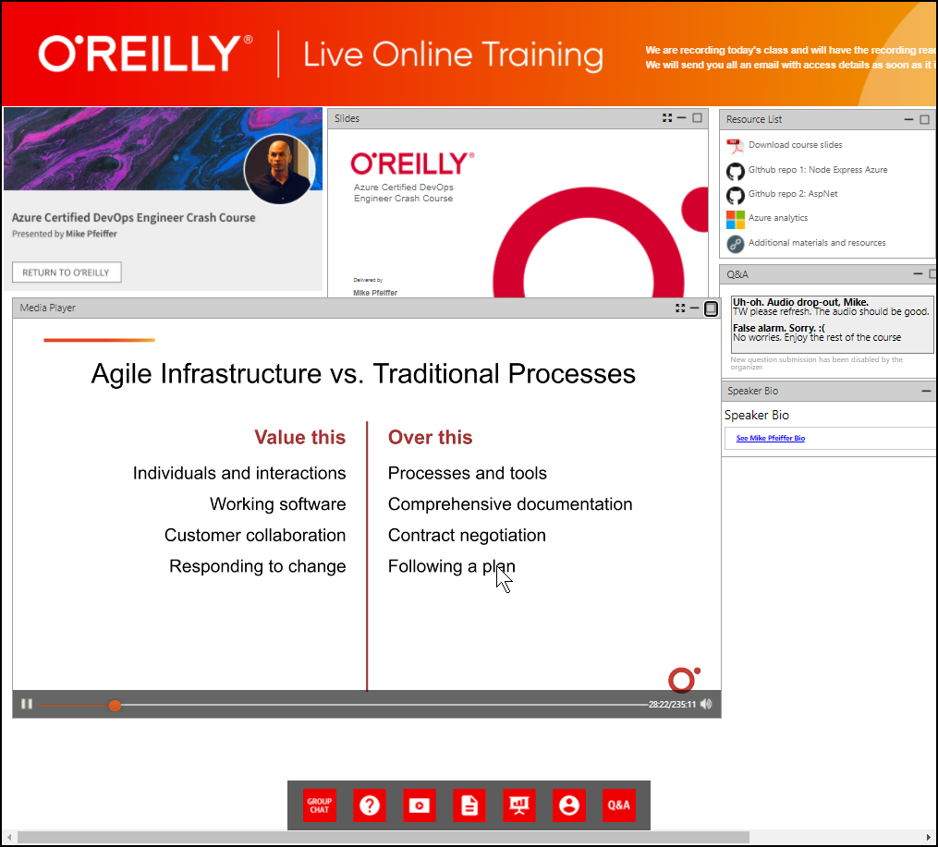
Session Recordings

Slide 10
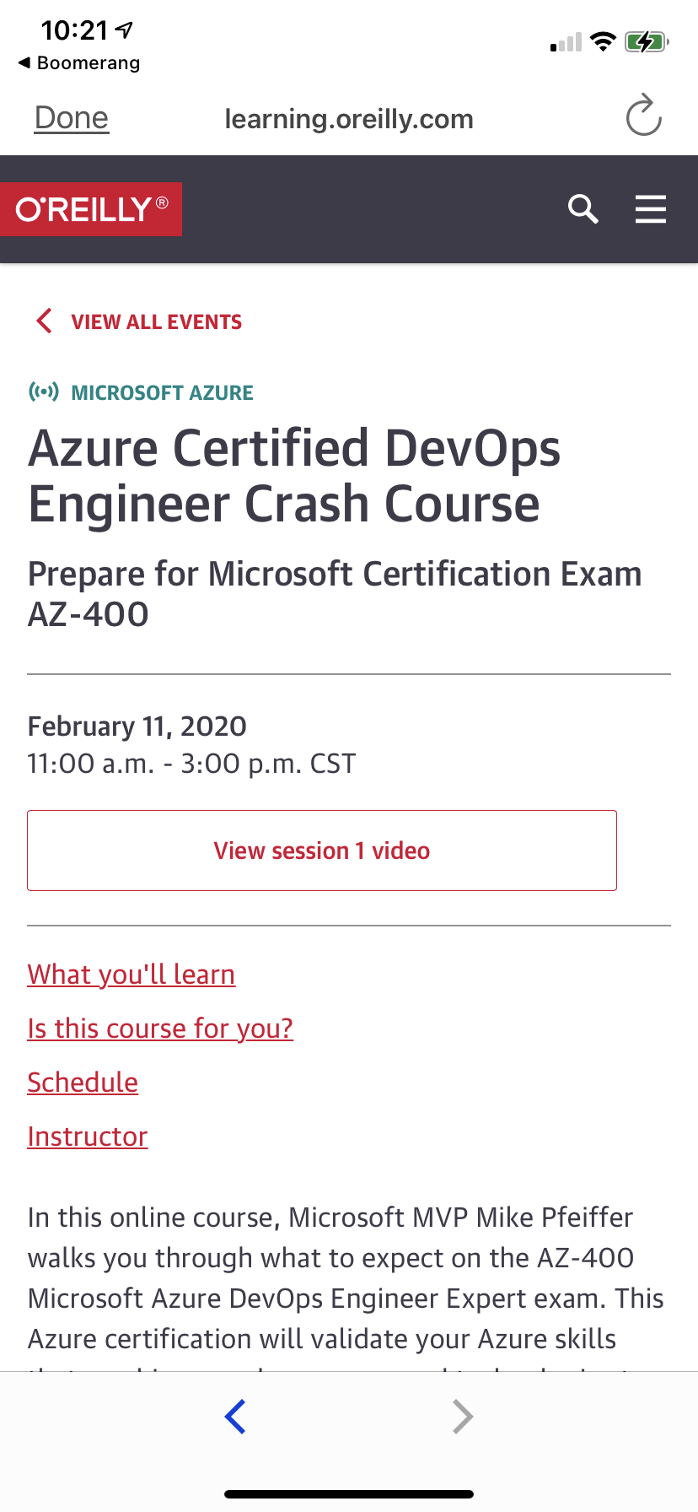
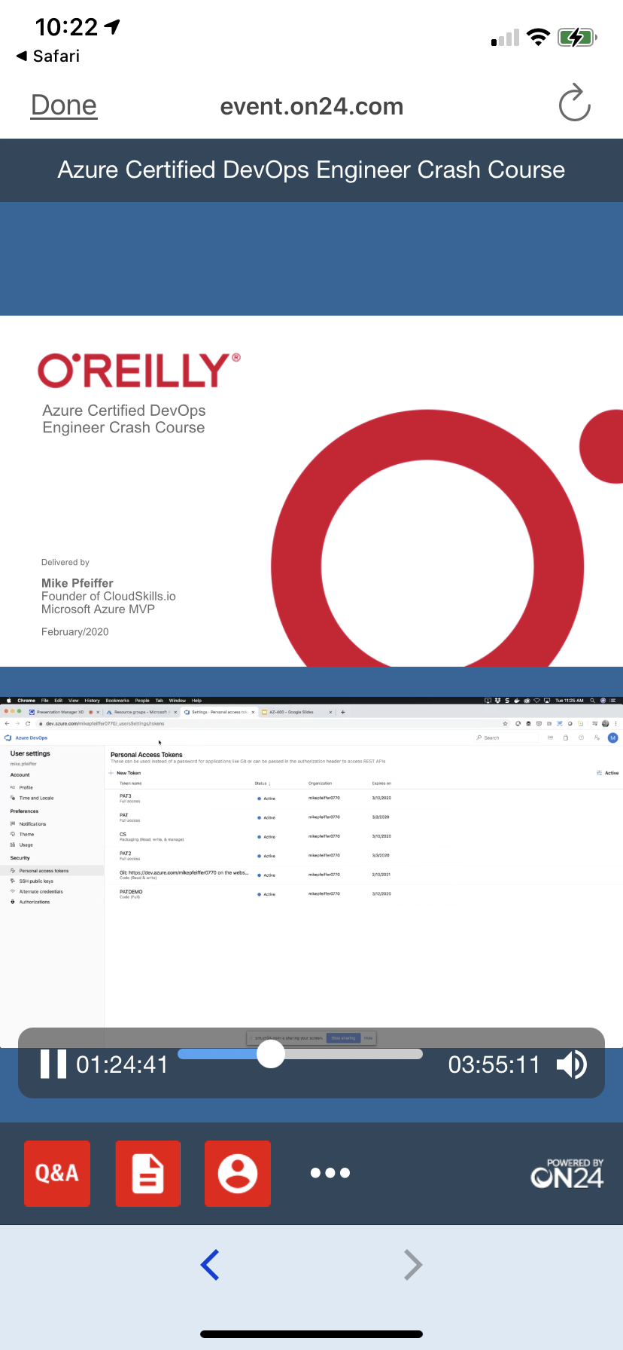
Mobile Browser: learning.oreilly.com

Slide 11
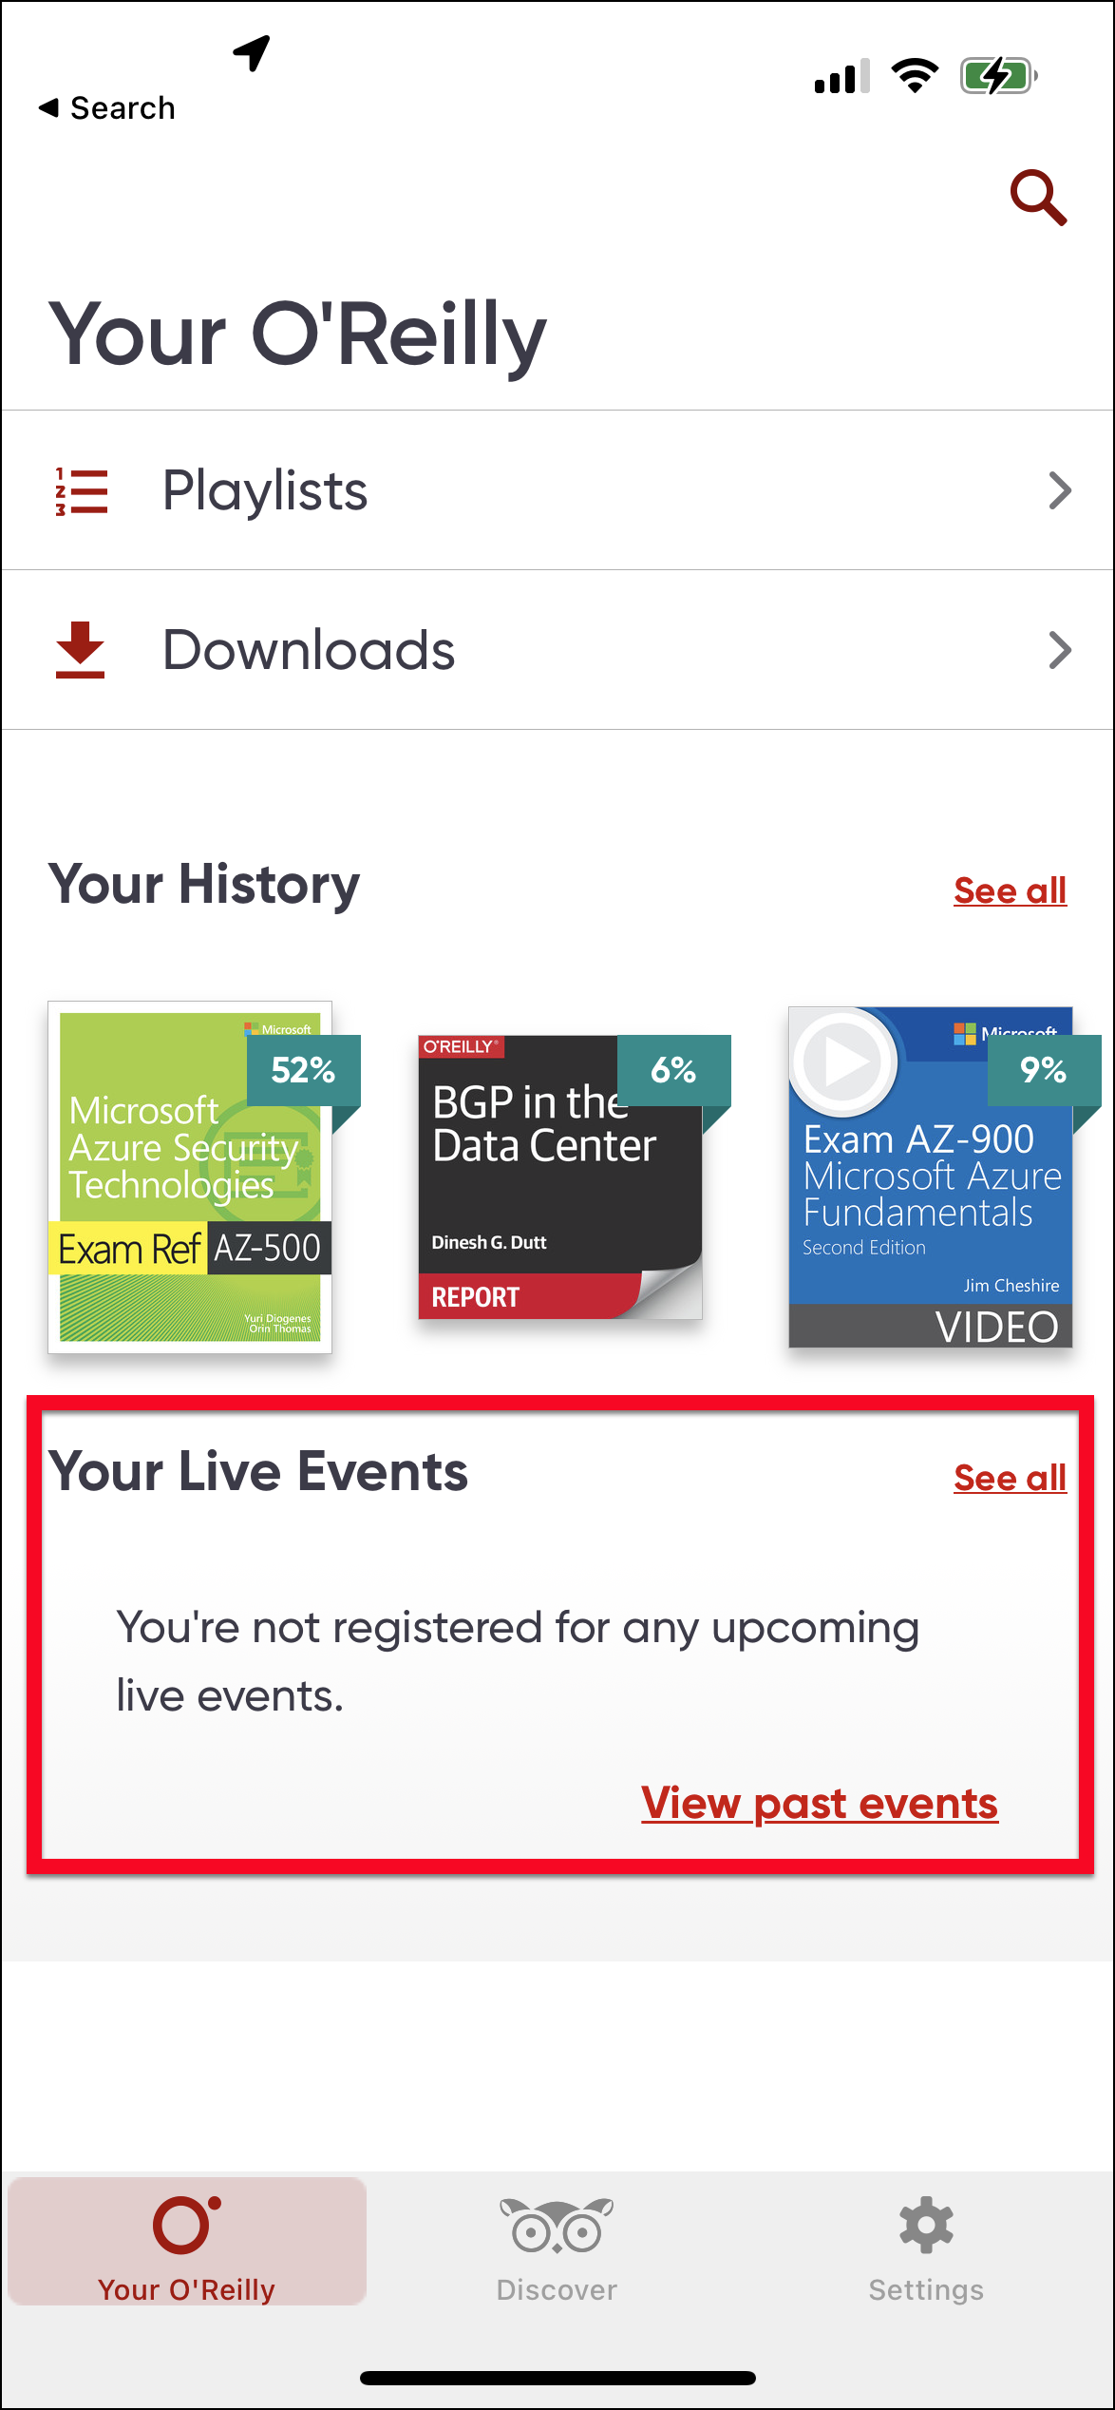
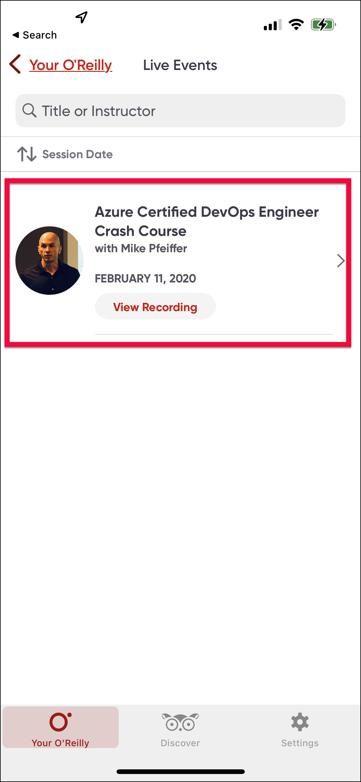
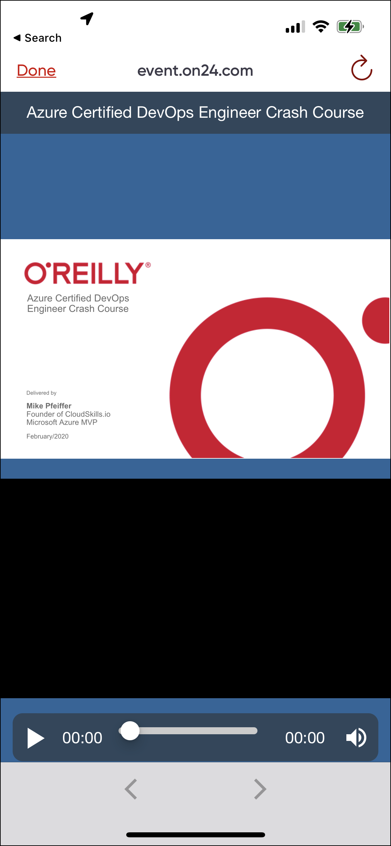
O'Reilly Mobile App

Slide 12
Security Operations Analyst
AZ-104

Slide 13
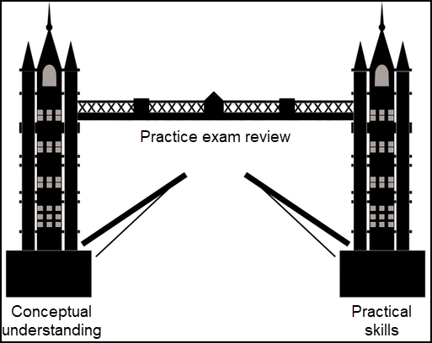
Tim's Certification Study Model

Slide 14
Thank you!
Course materials: timw.info/sc200
Twitter: @TechTrainerTim
Pluralsight: timw.info/ps
Web: timw.info

Slide 15
Title

